Slide 1
Sensors Vs Films
A comparison between analogue and digital imaging
By Omar Sirwan

Slide 2
Color locations and Size
ANALOGUE
4x5 cm has more than 200 million color locations. equivalent file size for 35-mm film image 15 Megabytes.
DIGITAL
A 5 million pixel sensor with interpolation will generate a 15 megabyte file in 24 bit color.

Slide 3
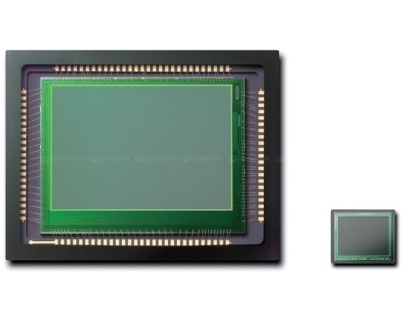
Coloring
colors in sensor are not actually recorded at each site of the sensor one-third of the color light was recorded only.
this problem solved in X3 sensor chip but it has fewer pixel locations.

Slide 4
Fill Factor
a sizeable amount of the surface of the sensor is dedicated to the electronics required to make the sensor function.
these areas contribute no information for image formation.
today the fill factor for many professional sensors is about 60%.

Slide 5
Sampling rate
The other issue is sampling rate which is simply reflects the amount of detail that is captured. it can be said that minimum of 2 pixels are required to record a detail that is 1 pixel wide.

Slide 6
Storage problem
major improvements have been made in removable media, but these storage media are still part of the problem. returning to the issue of image size, we want the in-camera media to hold our images at their highest resolution.
and when the image is modified in anyway data are lost thus the photographer will want to use uncompressed files onboard.

Slide 7
Digital photographic capture By Glenn Rand,David Litschel,Robert Davis P170-172‏

